Slide 1

Special Tube Plant
Advanced Heavy Water Reactor
Machine Layout Designing

Slide 2

NUCLEAR FUEL COMPLEX

Slide 3

DEPARTMENT
OF
ATOMIC ENERGY

Slide 4
Structure of Presentation
Part I
DAE & NFC
Part II
Special Tube Plant
(STP)
Part III
Operations in STP
Part IV
Layouts for AHWR

Slide 5
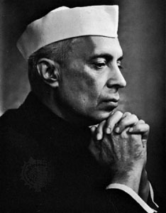
DAE Founded on
3rd August 1954
-“Atomic Energy is going to play a vital role in the coming years for the benefit of India and the world”

Slide 6


















Slide 7
Functions of DAE
Energy Security
Agriculture
Education & Health
Food & Nutrition Security
Water resources improvement

Slide 8
Status of Energy Production in India
In 2013 India ranked the 3rd place in the field of electricity generation.
Production about 1.1 X 10³ TWhr.
Which is about 10¹² units.

Slide 9
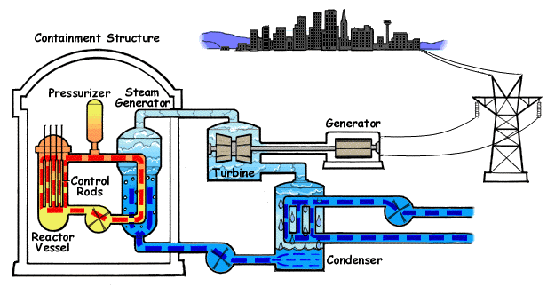
How Nuclear Reactor generates electricity ?

Slide 10
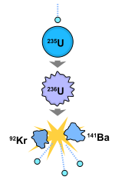
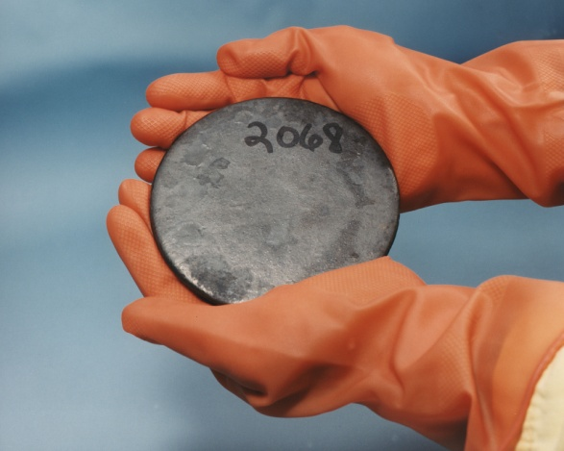
Materials for Fission
Uranium 235
235
U
92
Enriched Uranium

Slide 11

Fission Reaction
235
U
+
1
n
141
Ba
+
96
Kr
+
3
n
+
1
q
92
0
56
36
0

Slide 12
Advantages of
Nuclear Energy
Clean
Affordable
Long lasting
High power density

Slide 13
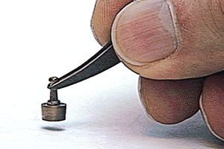
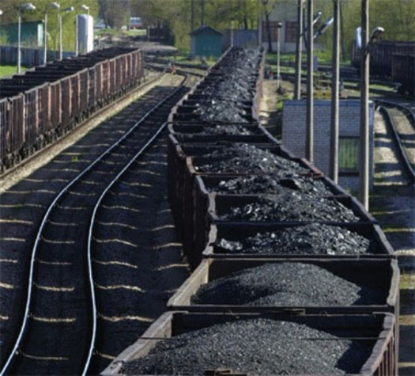
1 gm
235
U
92
2.7 tons
of coal

Slide 14
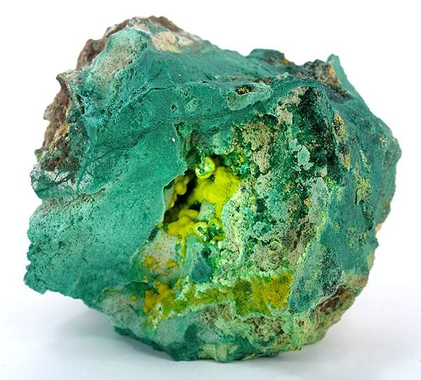
238
U
235
U
92
92
99.27%
0.729%

Slide 15
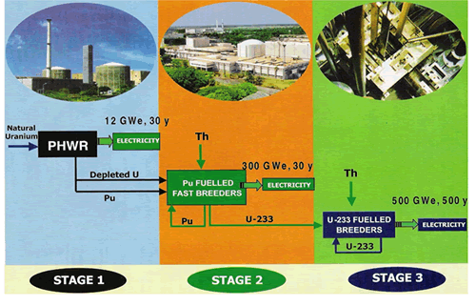
India’s Three stage Nuclear plan

Slide 16
BWR
Boiling Water Reactors
PHWR
Pressurized Heavy Water Reactors
FBR
Fast Breeder Reactors
AHWR
Advanced Heavy Water Reactors

Slide 17
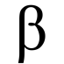
PHWR
Nuclear Reaction
238
U
+
1
n
92
0
239
U
-
239
Np
92
23.5 min
93
2.36
days
-
239
Pu
94

Slide 18
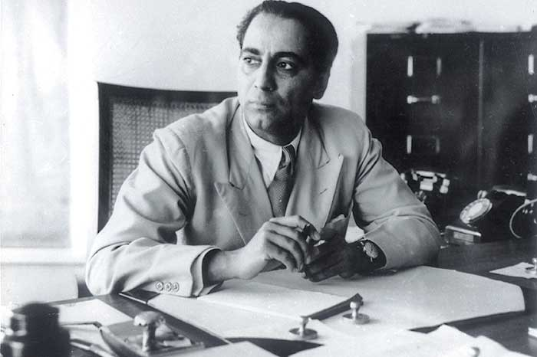
Dr. Homi Jehangir Bhabha
Father of Indian Nuclear Programme

Slide 19

NUCLEAR
FUEL
COMPLEX

Slide 20
Functions of NFC
Supply hardware components to all nuclear reactors in India.
Reactor mountings and accessories.
Special materials to companies like ISRO, etc.

Slide 21
Components of Nuclear Reactor
Moderator

Slide 22
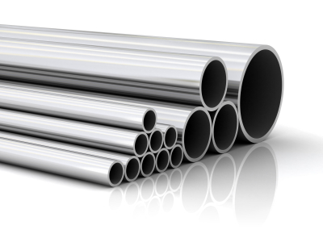
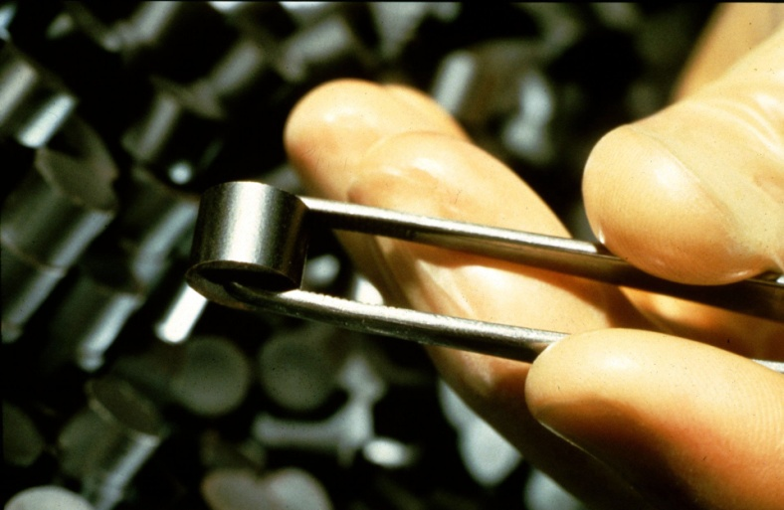
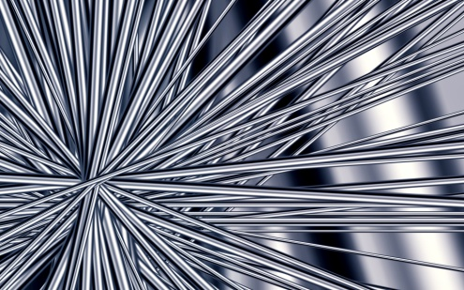
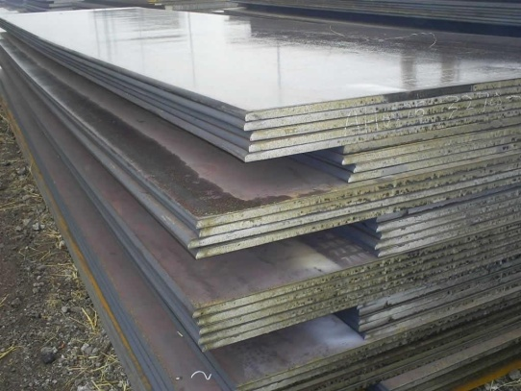
Production in NFC
Tubes
Rods
Uranium Fuel Pellets
Sheets

Slide 23
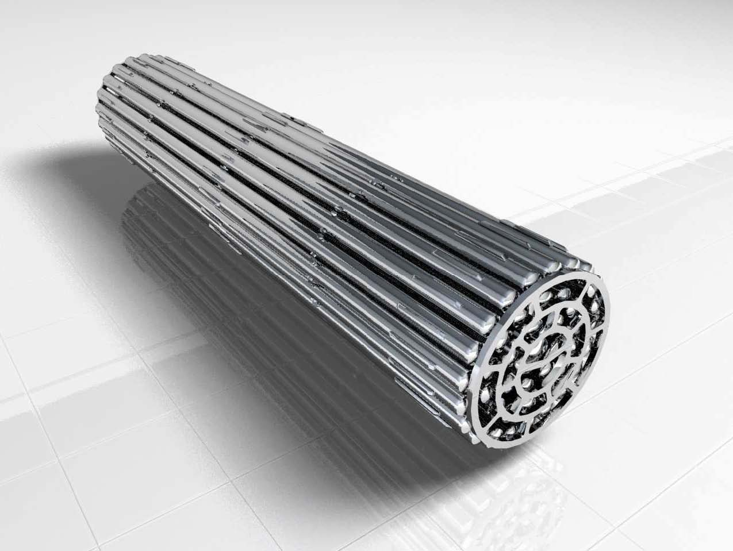
FUEL BUNDLE

Slide 24
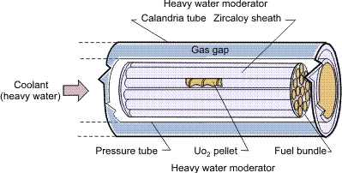

Slide 25
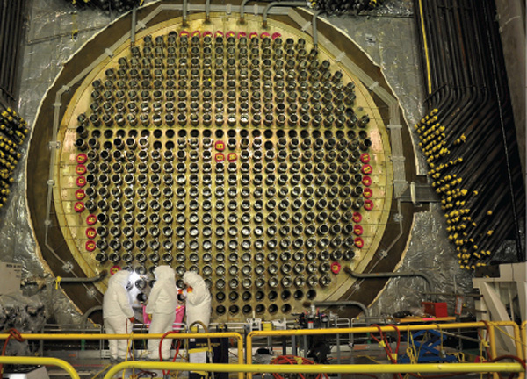
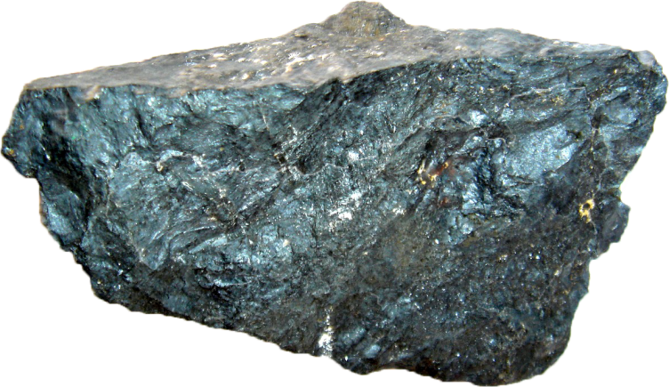
Ore
Core

Slide 26
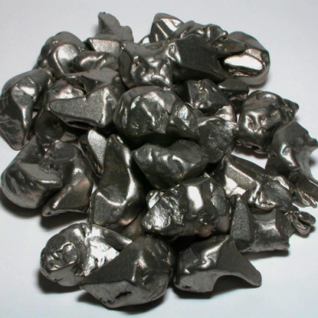
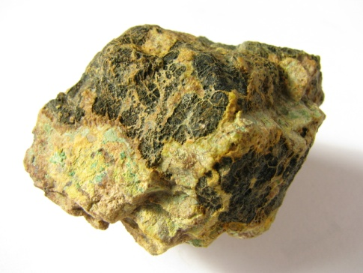
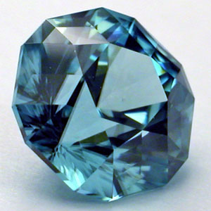
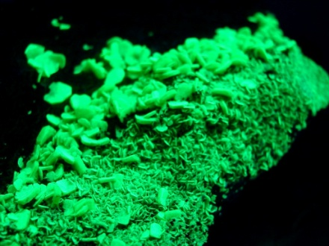
Material flow in
NFC
Zirconium
Uranium

Slide 27

Zirconium
Dissolution
Solvent Extraction
Precipitation
Filtration
Chlorination
Distillation
Reduction
Zr sponge

Slide 28
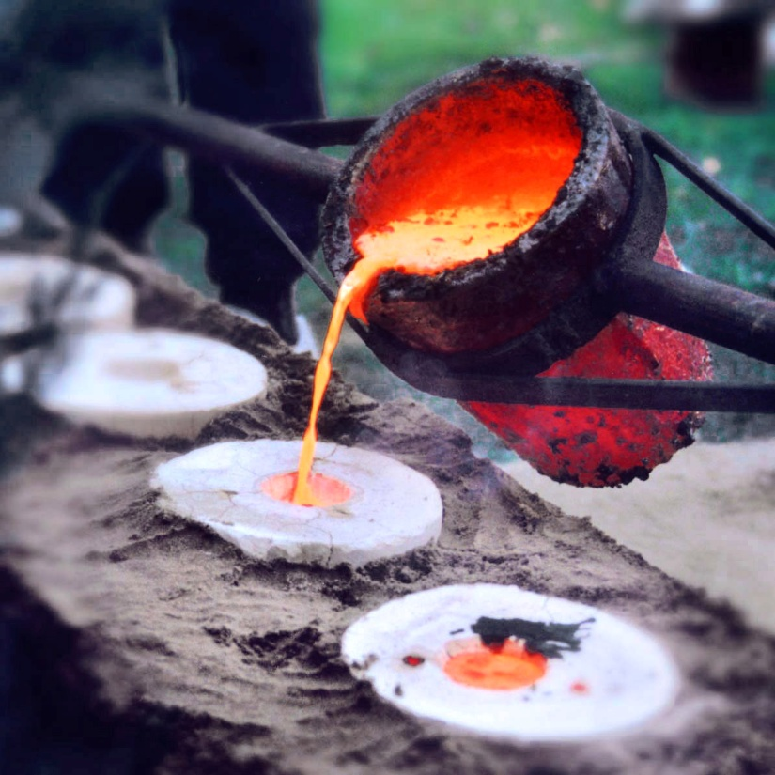

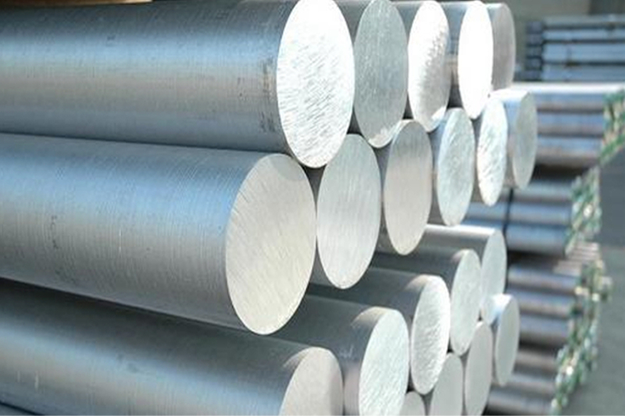

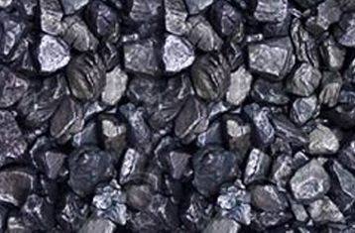
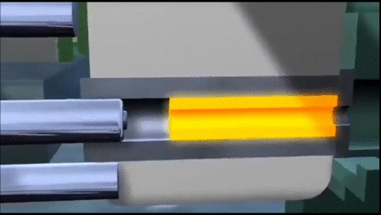
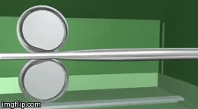
Zr sponge
Alloying & Melting
Billets
Hot expansion
Hot Extrusion
Cold Pilgering
Dispatch

Slide 29

Uranium
Dissolution
Slurry Extraction
Precipitation
Filtration
Drying
Calcination
Reduction
UO₂ powder

Slide 30
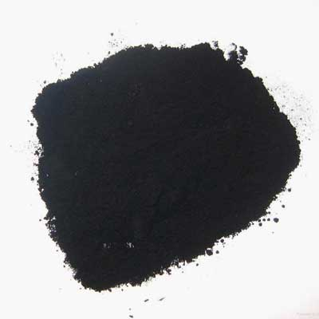
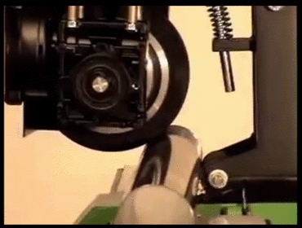
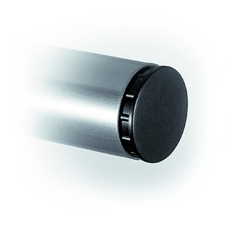
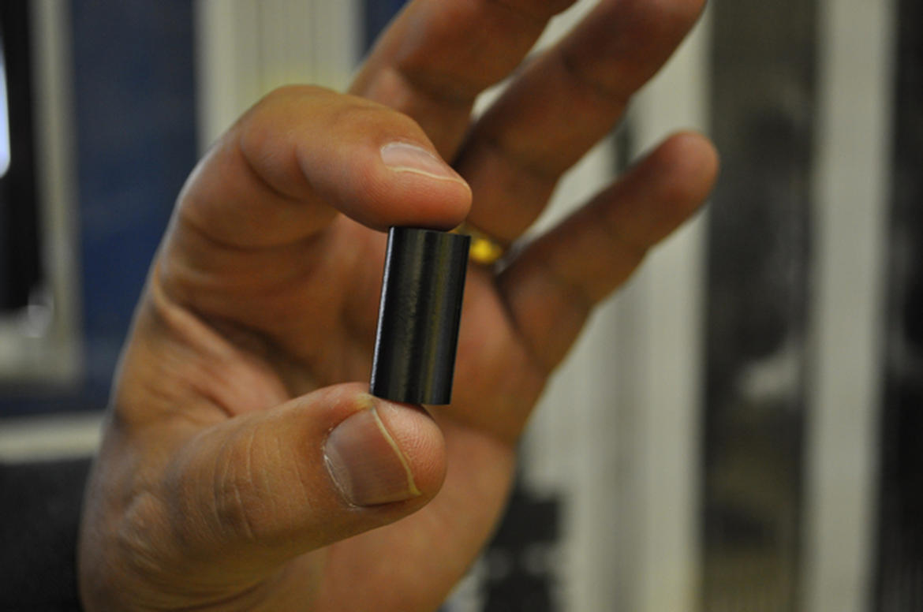
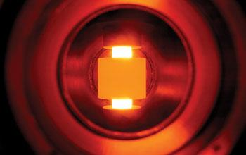
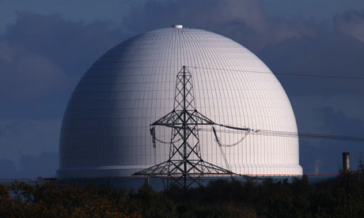
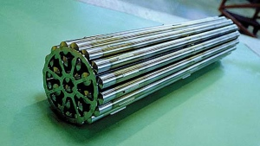
UO₂ powder
Compaction
Sintering
Grinding
Loading
End welding
Bundle formation
Dispatch

Slide 31
Special Tube Plant
Advanced Heavy Water Reactor
Machine Layout Designing

Slide 32
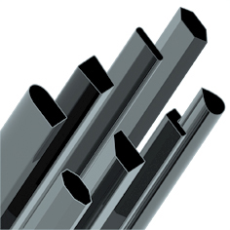
Special Tube Plant
Manufacturing of special tubes for nuclear reactor components.

Slide 33
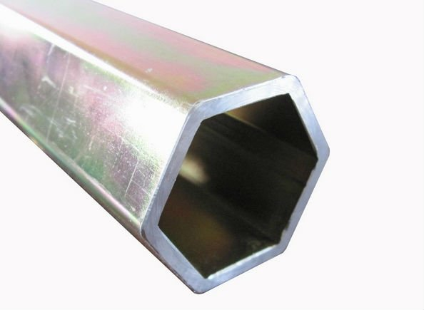
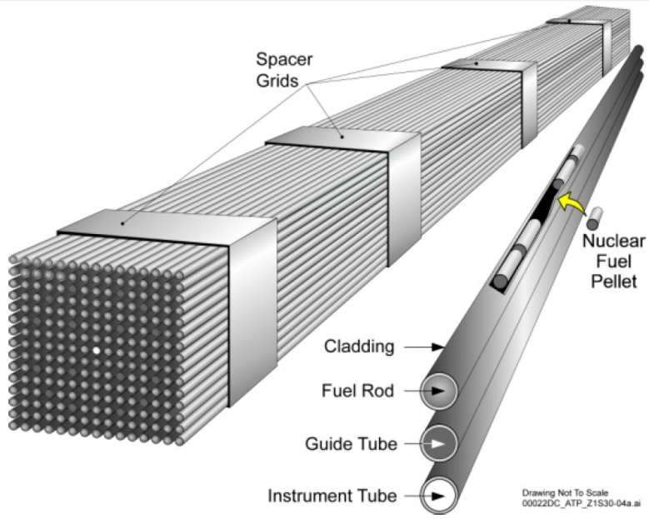
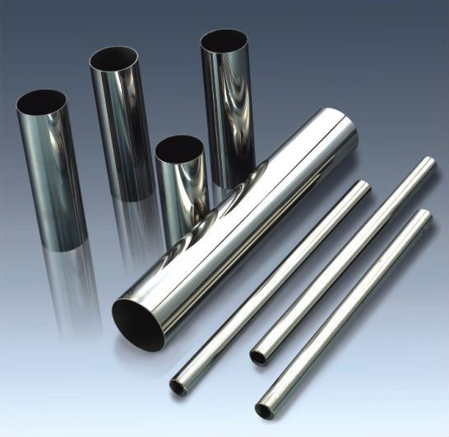
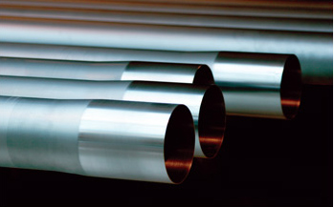
PFBR
STP
BWR
PHWR

Slide 34

Properties of Zirconium
Beneficial properties:-
Low neutron cross section.
High corrosion resistance.
High strength at elevated temperatures.
Found abundantly in India.

Slide 35
Mechanical properties:-
Mass density – 6530 kg/m³
Melting point – 1853 ºC
Yield strength – 230 MPa
Young’s modulus – 94.5 GPa
Brinells Hardness – 145
Rockwell B Hardness – 78
Vickers Hardness – 150
Coefficient of linear expansion ‘α’ – 5.8 mm/mK
Thermal conductivity – 16.7 W/mK
Zr
40
91

Slide 36
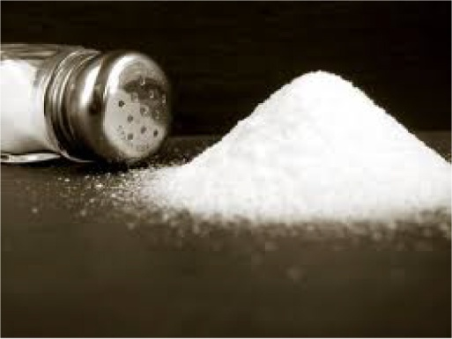



Other properties

Slide 37
Alloys of Zirconium
Zircaloy 2
Sn – 1.2-1.7
Calandria
Fe – 0.07-0.2
α - HCP
Zircaloy 4
Sn – 1.2-1.7
Calandria
Fe – 0.18-0.24
α - HCP
Cr – 0.07-0.13
Zr 2.5 Nb
Nb – 2.5-2.8
Pressure
α+β - HCP & BCC

Slide 38
Project Statement
AHWR
300 - 500 GWe
500 years
Reactor hardware components.
Fuel assemblies.

Slide 39
Project Statement
STP
Plant machine layout.
PHWR pressure tube manufacturing route.

Slide 40
Project Statement
STP
AHWR
New machine layout.
PHWR pressure tube manufacturing route.
Minimum traverse length.

Slide 41
STUDY OF STP

Slide 42
Machines and
Instruments
Machining
Forming
Quality check
Measuring

Slide 43
Machining
End cutting machine
Honing machine
I/D polishing machine
O/D polishing and grinding machine
Lathe
Pneumatic roller/grinder

Slide 44
Forming
Roller straightening
Pilgering
Alkali degreasing
Autoclaving
Annealing

Slide 45
Quality Check
Ultrasound testing
Eddy current testing
Boroscopy
Pressure testing

Slide 46
Measuring
Measuring tape
π (Pi) Tape, Vernier Callipers
Bore gauge
Skid stylus
Snap gauge, Ovality snap gauge
Dial test indicator, Bow foot

Slide 47
Tube
Manufacturing
Process

Slide 48
1
Extrusion
2
Dejacketing
25
Sizing
3
Roller Straightening
26
Pressure Testing
4
End Cutting
27
HWBC & HWC
5
Degreasing
28
Lathe operations
6
Annealing
29
Weight of tube
7
ID Conditioning
30
Autoclaving
8
Roller Straightening
31
Hand Straightening
9
11
Quality Check
Honing
&
OD Grinding
10
Degreasing
Dispatch
a
12
Quality Check
c
b
13
Ultrasound Testing
d
14
Pilgering
15
Degreasing
16
Roller Straightening
17
End Cutting
18
20
Honing
&
OD Polishing
Degreasing
19
e
21
h
Ultrasound Testing
f
22
Eddy current Testing
23
Grit Blasting
g
24
i
Boroscope

Slide 49
EXTRUSION
POLISHING
ANNEALING & STRAIGHTENING
PILGERING
CLEANING &HONING
TESTING
AUTOCLAVING

Slide 50
Study of STP
Layout

Slide 51
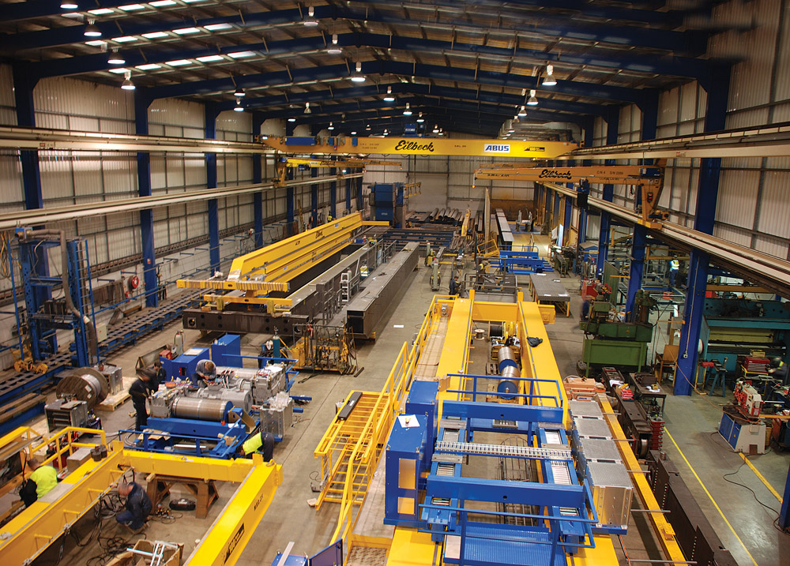
Relative Positioning Method

Slide 52
Representation in Excel
One Crane Pillar Unit

Slide 53
STP
Layout

Slide 54
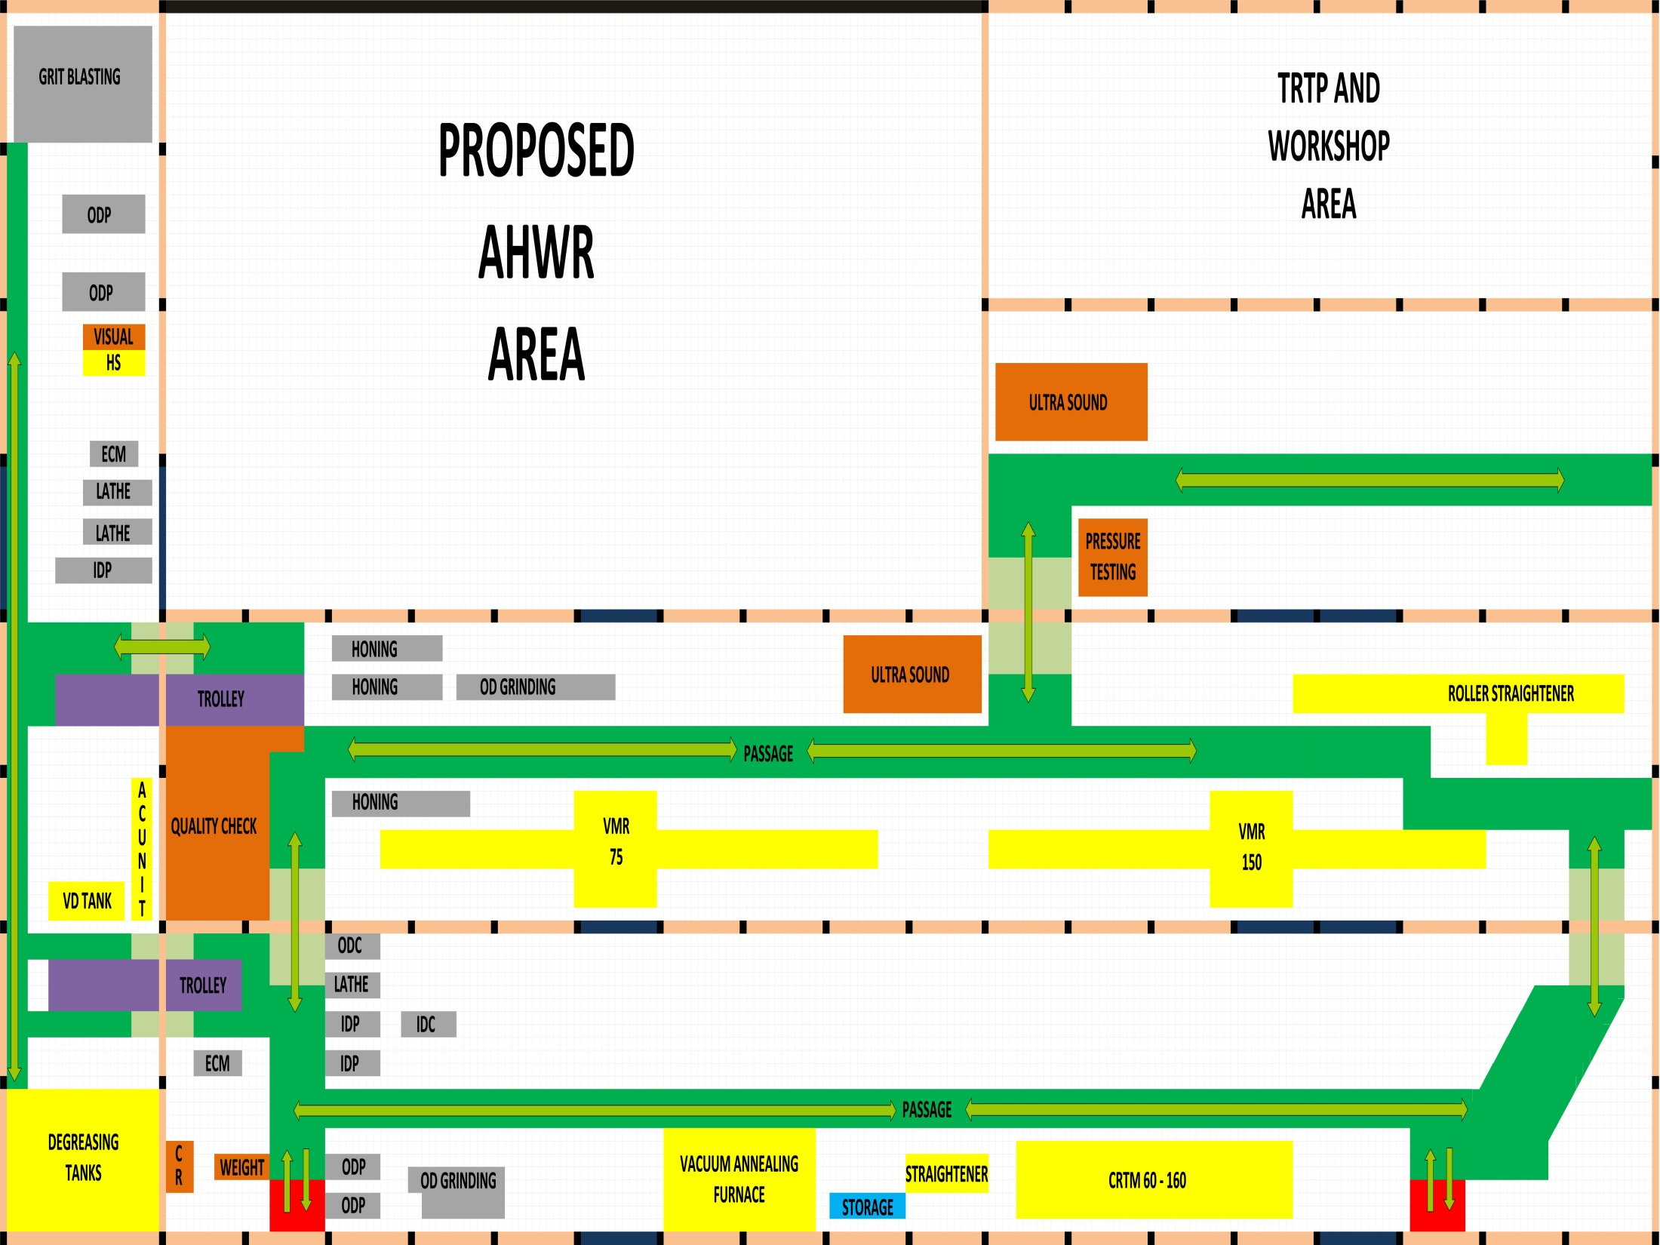

Slide 55
AHWR design and study implementation

Slide 56
Plant Layout types:-
Product layout
Process layout
Ranking method

Slide 57
Product layout
Machines are arranged according to the process of manufacturing.

Slide 58
Process Layout
Arranging machines according to their function.

Slide 59
Ranking method
According to the priority of operations like repetitiveness, space, etc., analogous to the mathematical ranking method.

Slide 60
Product layout
of
AHWR

Slide 61
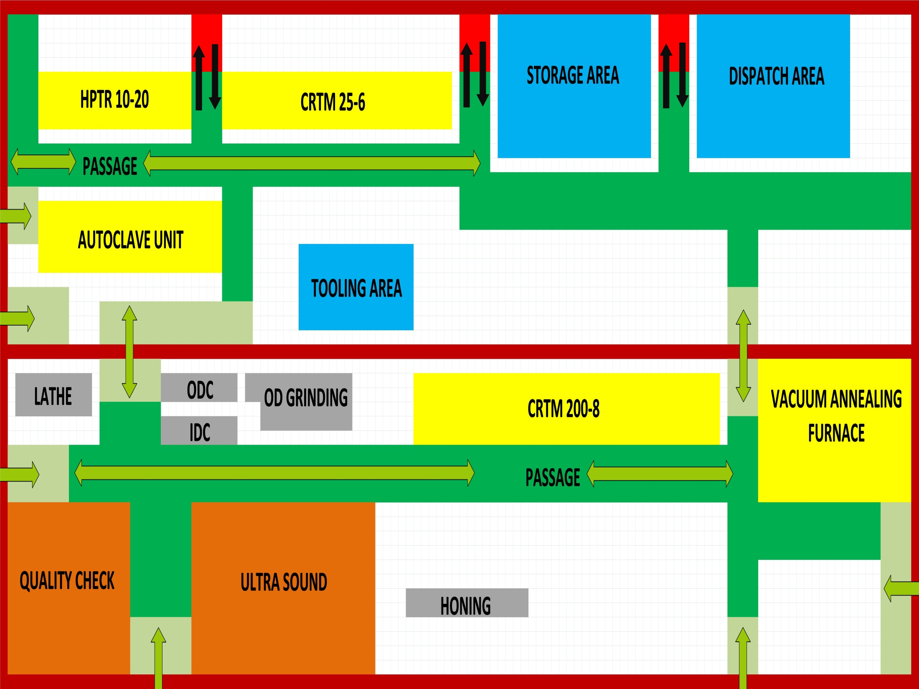

Slide 62
Process layout
of
AHWR

Slide 63
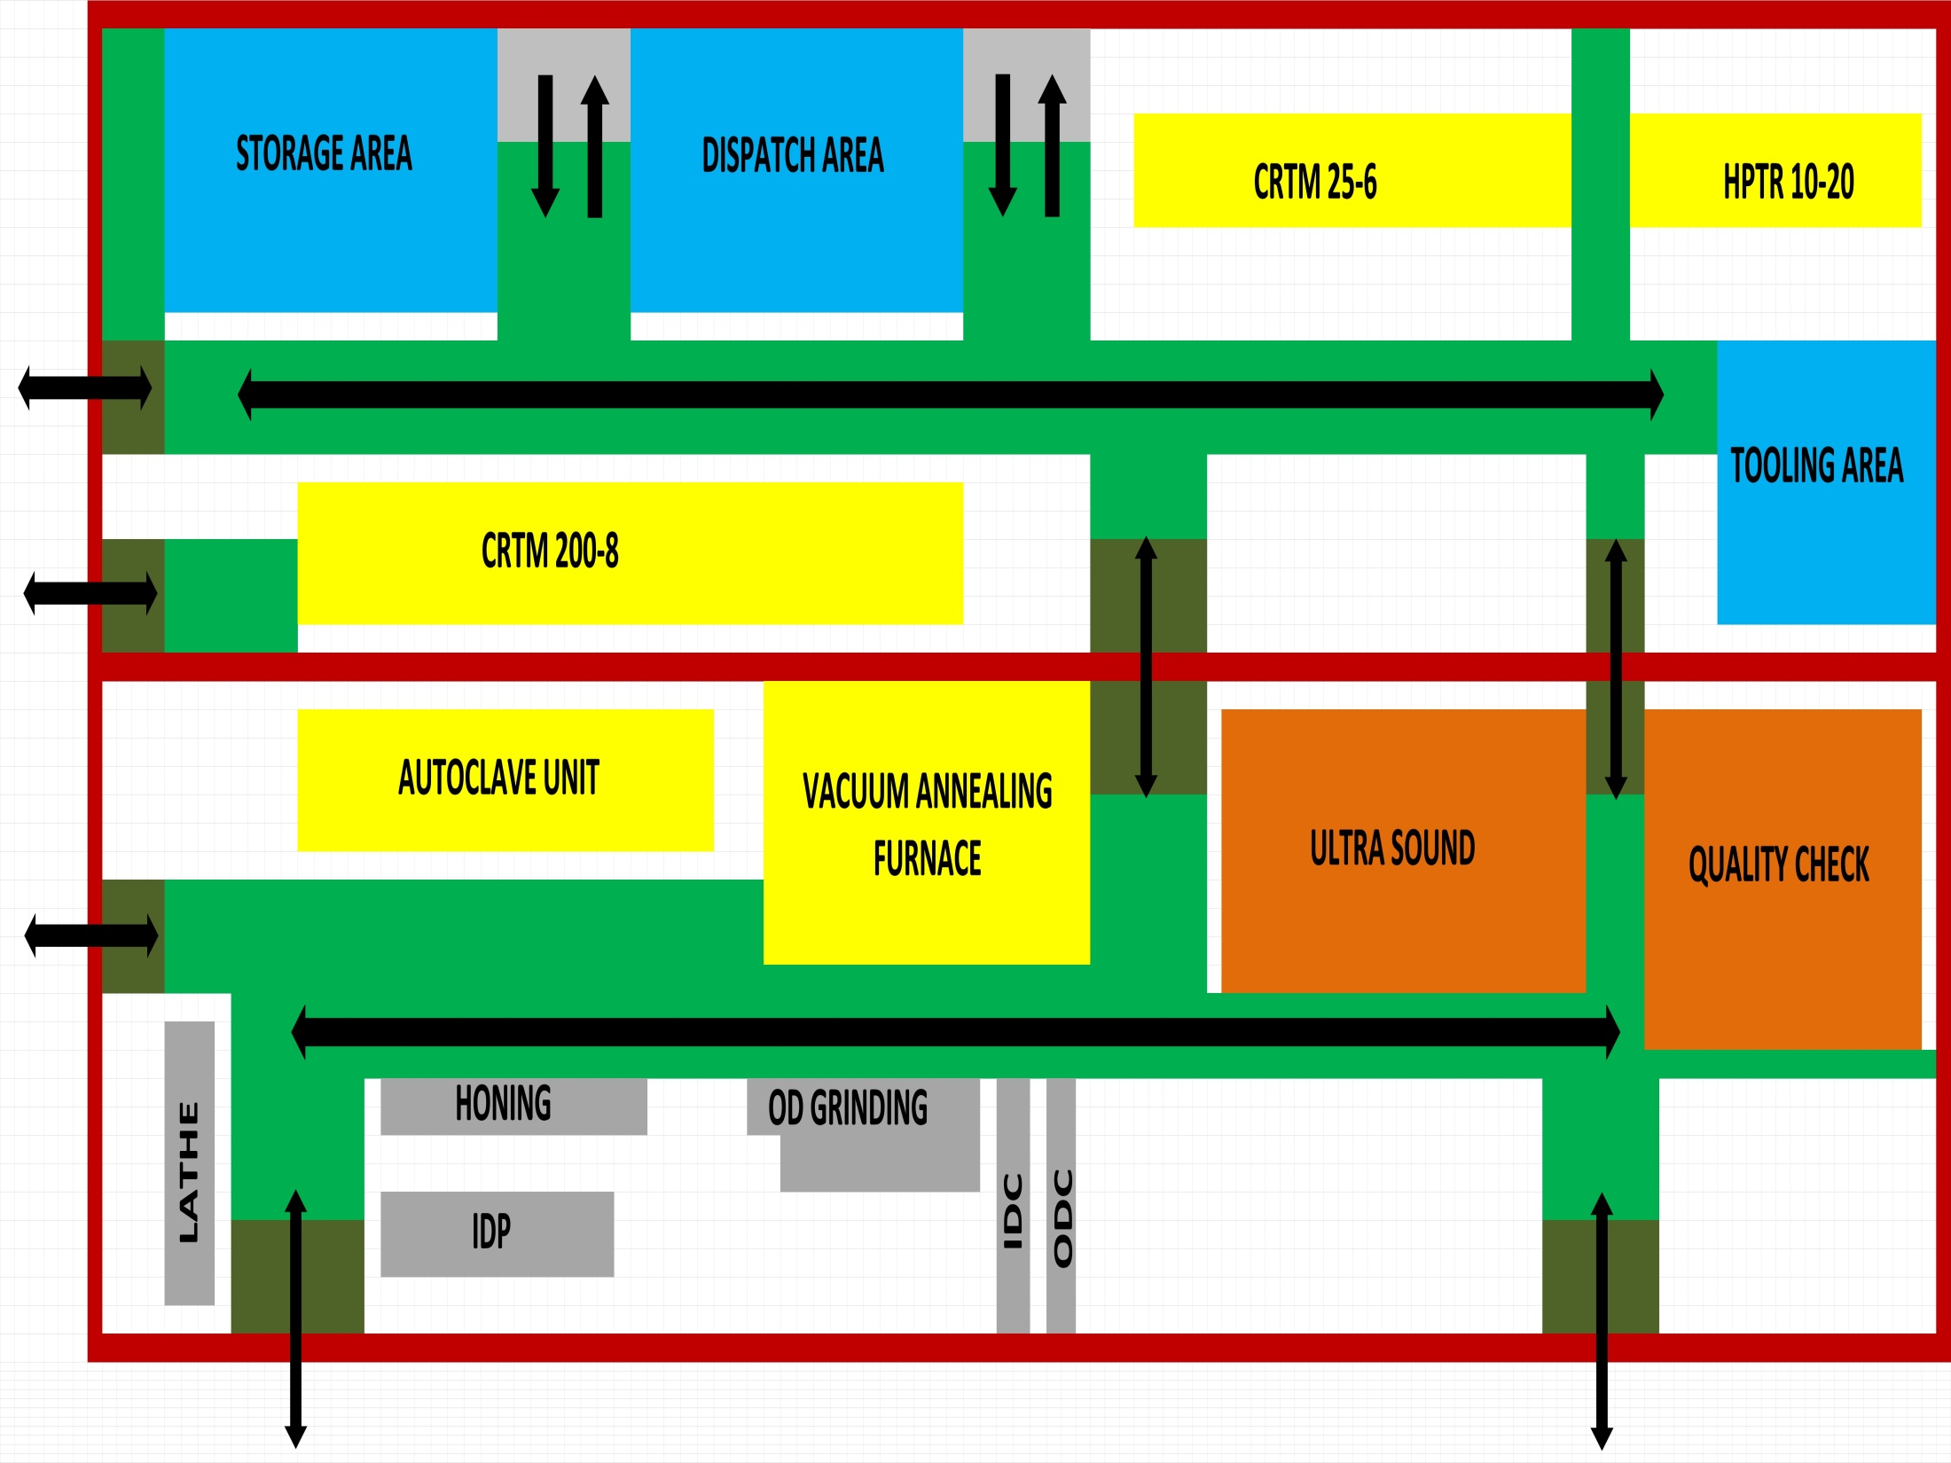

Slide 64
Ranking method
of
AHWR

Slide 65
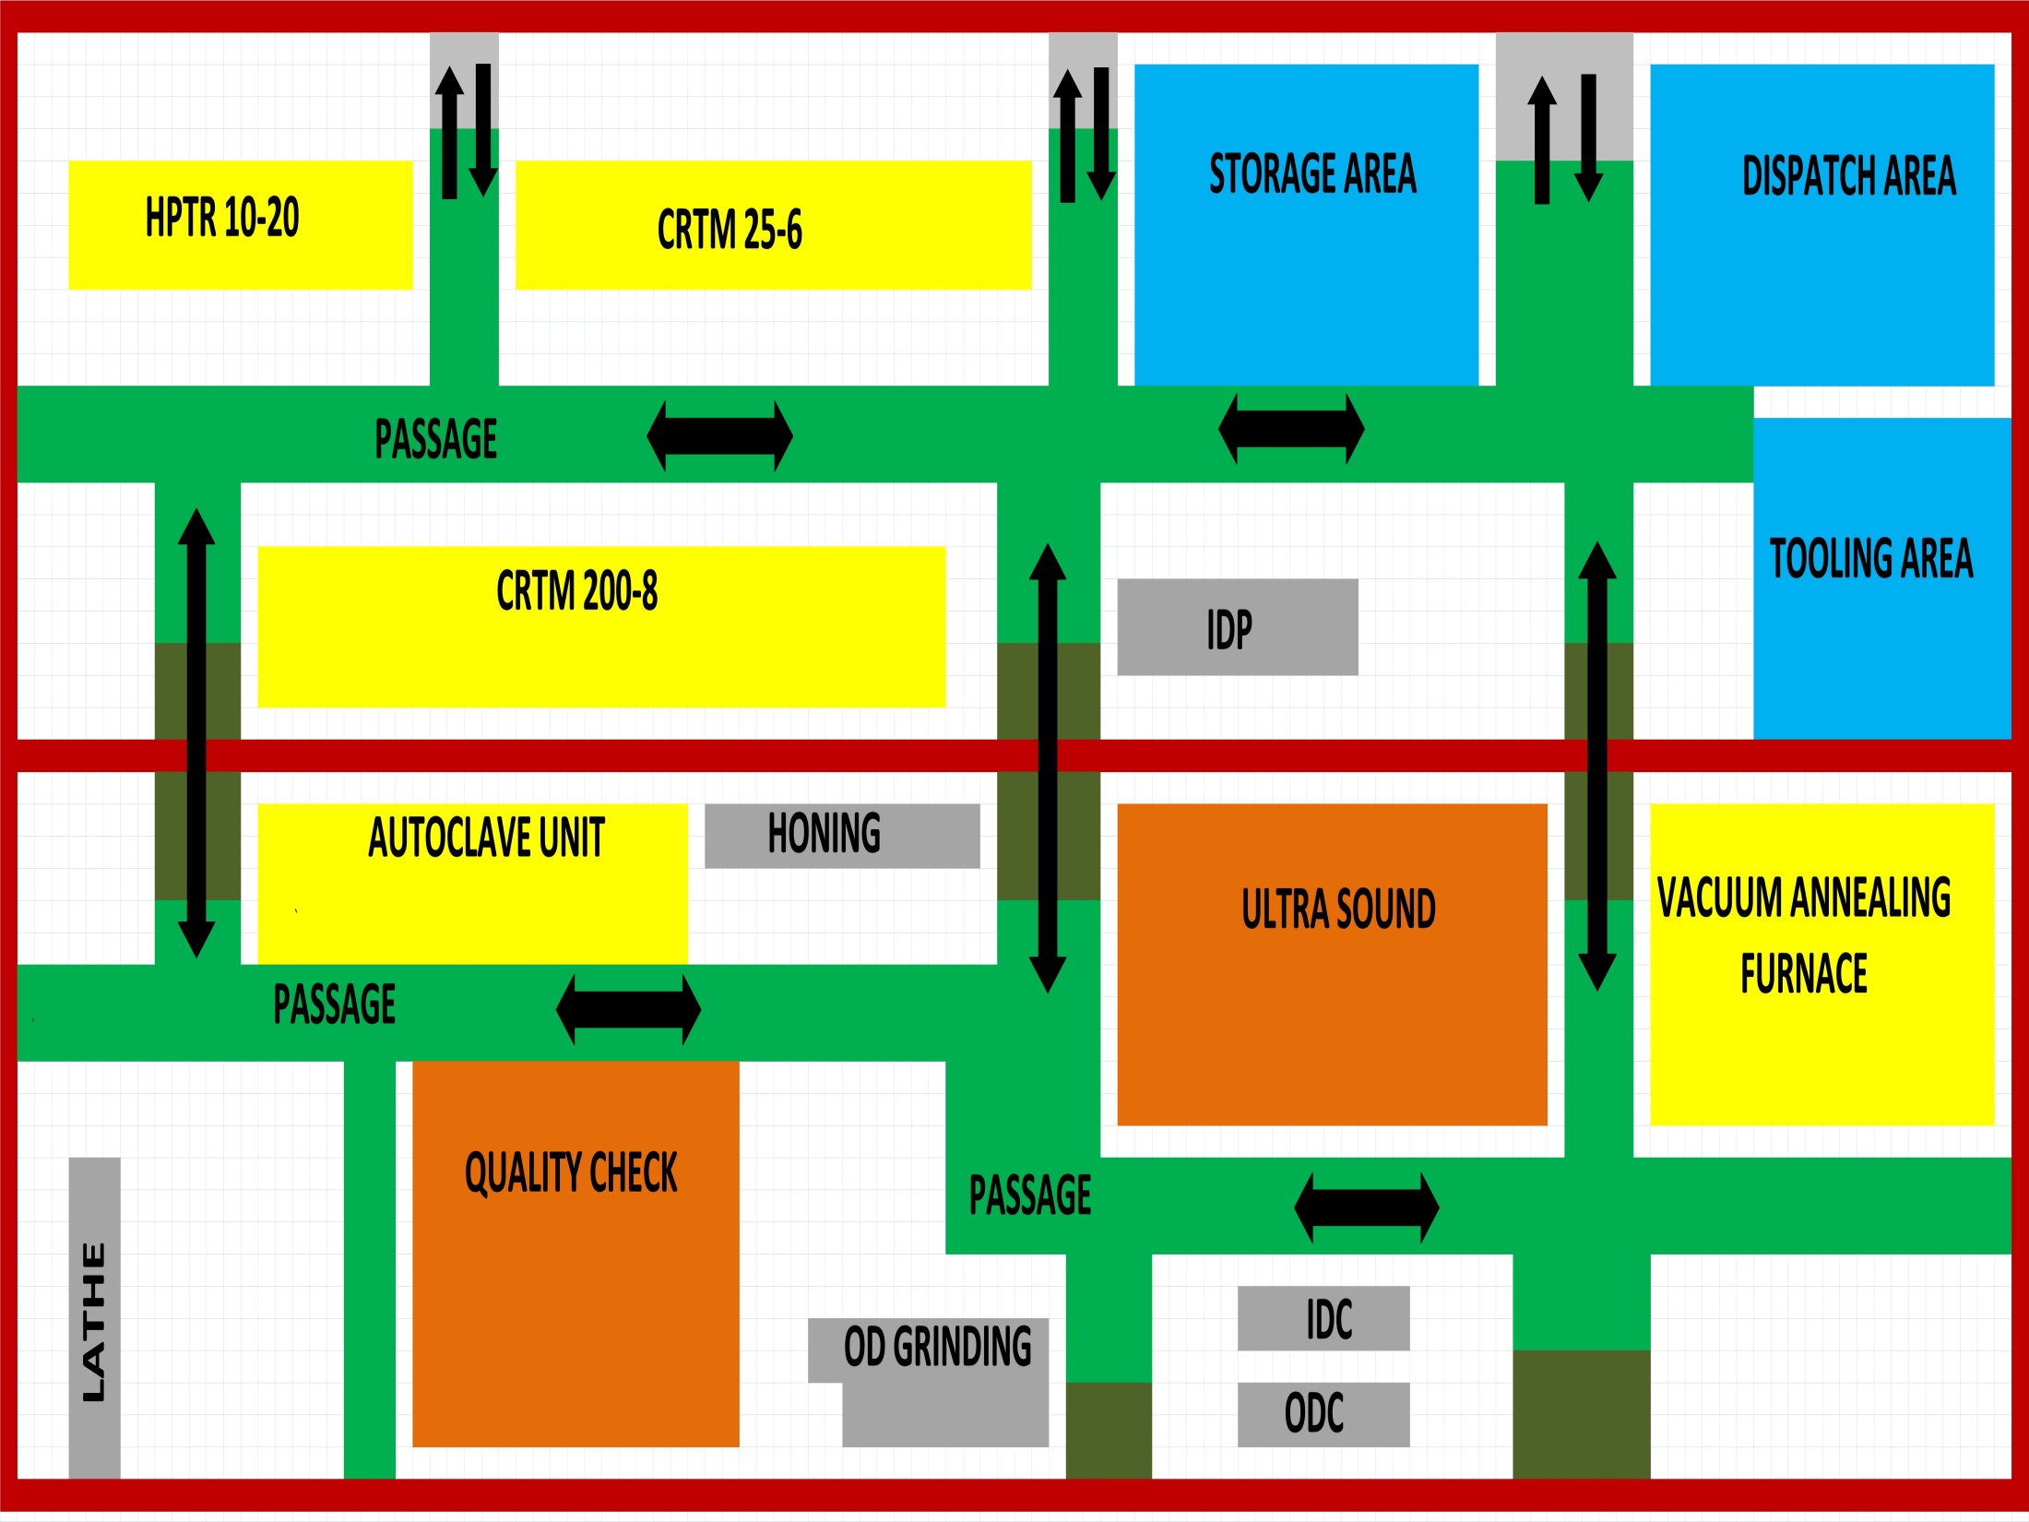

Slide 66
OPTIMISED LAYOUT
Arrangement according to the will and convenience of the worker and space limitation.
Selecting the short path of machine from all layouts and arranging them will not do the job, giving correct reason for machine position should be justified.

Slide 67
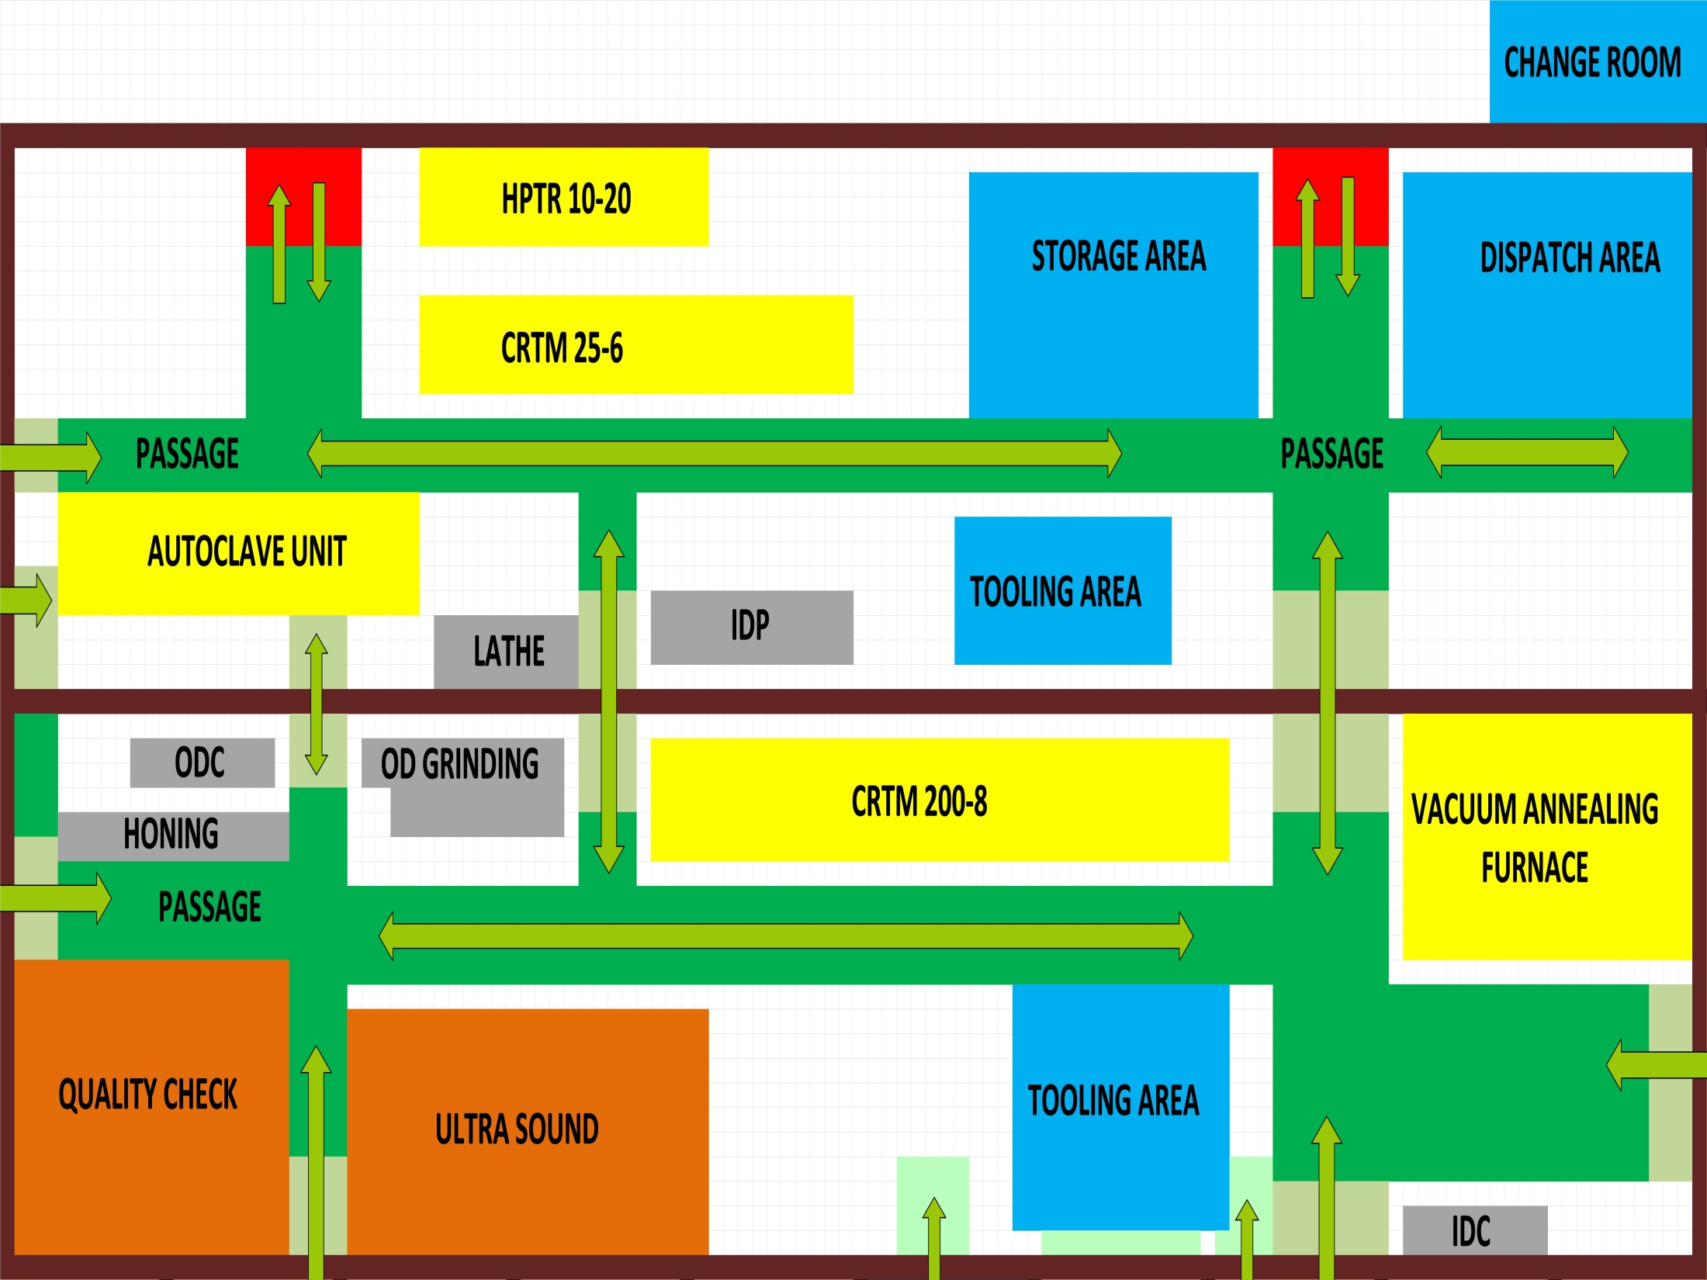

Slide 68
STUDY OF LAYOUTS
Few criteria have been selected which denotes that the layout is comfortable and best suitable:-
Length
Time
Bay transfer
Defect length

Slide 69
Criteria | STP | Product | Process | Ranking | Optimised
Length | 3364 | 3136 | 3140 | 3192 | 2836
Time | 112 | 104 | 105 | 106 | 94
Bay transfer | 19 | 18 | 21 | 21 | 21
Defect length | 2744 | 2136 | 2836 | 2340 | 1606

Slide 70

HPTR & CRTM
Long tubes up to 30 m can be stored and dispatched easily.
As both machines are placed close to each other, the tube can go to HPTR right after CRTM.
STORAGE & DISPATCH AREA
Near to road which makes to dispatch and store incoming tubes easily.

Slide 71
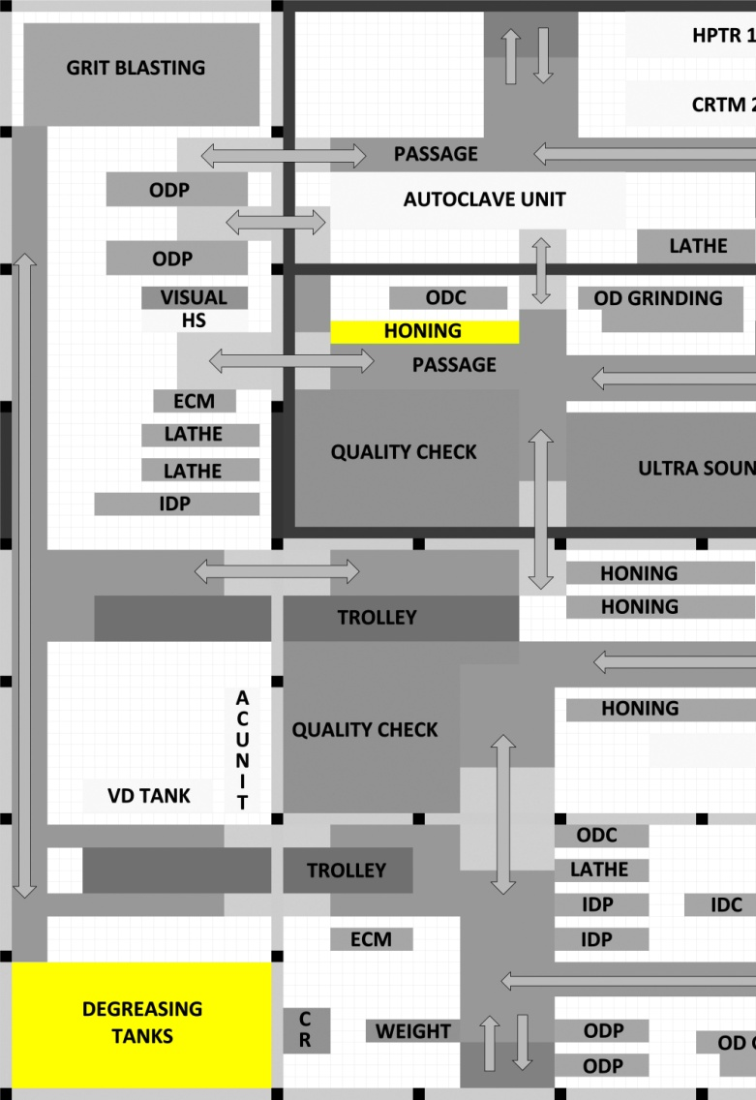
HONING
Maximum defects are on ID.
Even a small defect at mid position requires honing.
Coolant is applied for every honing.
.

Slide 72
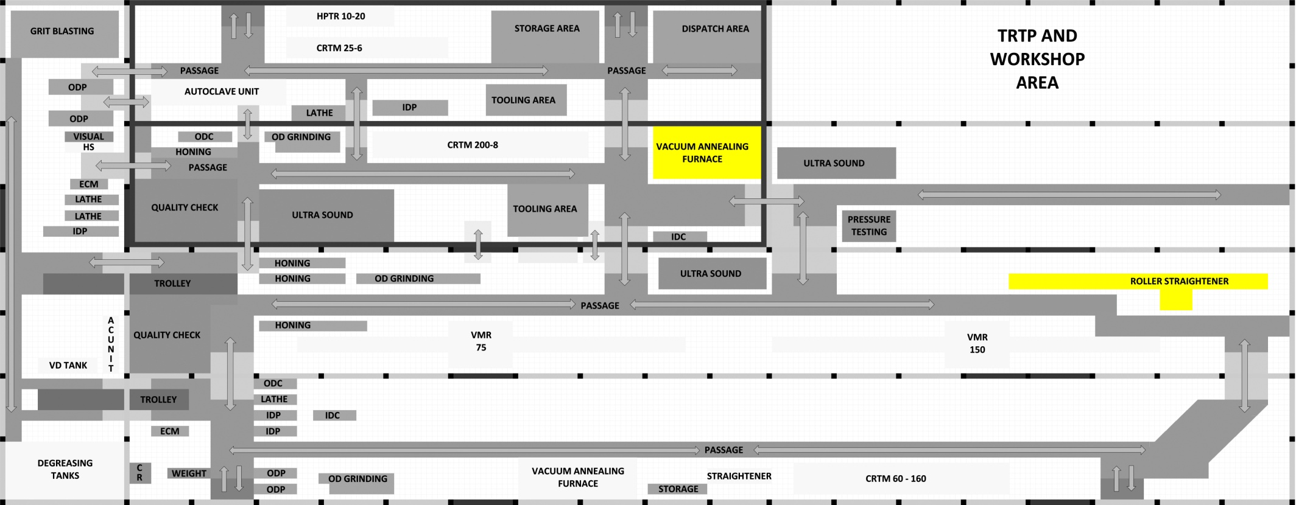
VACUUM ANNEALING FURNACE
Tube inner crests are machined in ID conditioning and then it is sent for roller straightener.

Slide 73
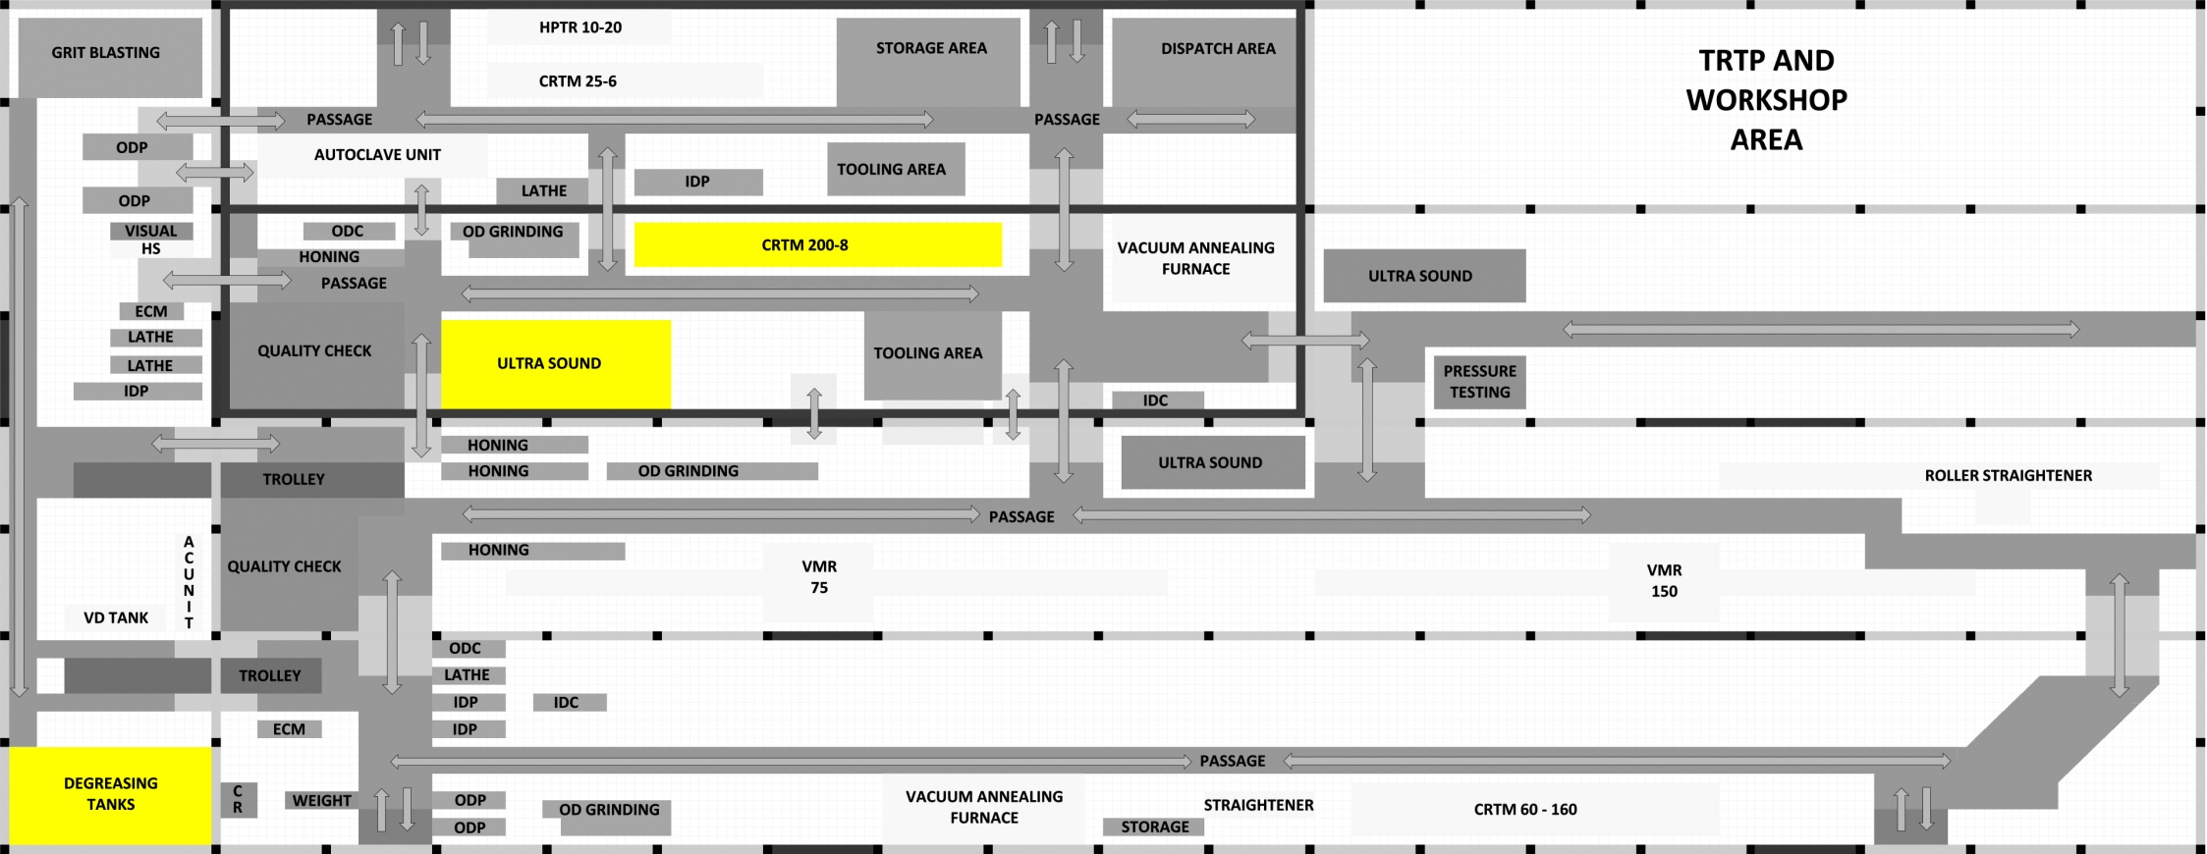
CRTM
After the ultrasound test tube is sent for the pilgering process in CRTM.
Due to lubricant application, it has to be degreased.

Slide 74
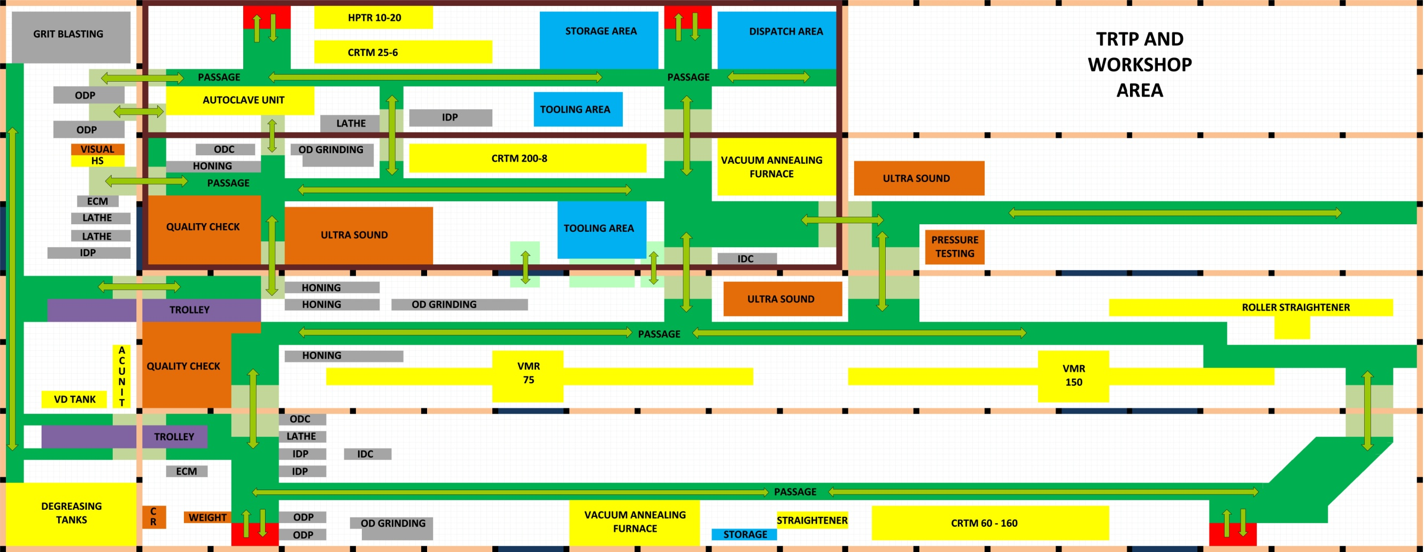
AUTOCALVE UNIT
After lathe, tube directly goes autoclaving.
After autoclaving, the hand straightening unit is very near this unit.
The operator of autoclave unit can take charge of OD grinding as it very near.

Slide 75

DEFECT CORRECTING MACHINES AND DETECTING UNITS
Quality check and Ultrasound testing detect the defects and the tube is sent to the respective machine accordingly.
In case of repeated defects, the tube will travel less length and communication is maintained.

Slide 76
CHOOSING THE BEST LAYOUT
TOPSIS method
Multi-criteria decision making.

Slide 77
Result of TOPSIS
Rank
STP Product Process Ranking Optimized

Slide 78
CONCLUSION
Drafted different layouts.
Selection of best by TOPSIS.
Each layout represent a particular notion of flexibility.

Slide 79
Thank
You

Slide 80
QUERIES
Please !!!

